Slide 1

Server 2019 – What’s New
WI VMUG October 2018

Slide 2








Mike Nelson
Sr. Technology Architect
@nelmedia
geektweakers.com
http://github.com/nelmediamike
Microsoft MVP, Azure Advisor
Citrix Technology Professional (CTP)
vExpert since 2012 – Wisconsin VMUG Leader

Slide 3


Hybrid Datacenter
Hybrid Cloud
Windows Server/WSSD
SQL/.NET/Containers
Azure Stack
On-premises

Slide 4
Windows Server 2019
Hybrid datacenter
Hyper-converged infrastructure (HCI)
Enhanced security
Application Innovation

Slide 5
Unique hybrid capabilities with Azure
Extend your datacenter to Azure to maximize existing investments and gain new hybrid capabilities
Azure Backup, Azure Site Recovery, and more
Storage Migration Services
Azure Network Adapter for connection to Azure virtual networks
Windows Admin Center: the hub for hybrid

Slide 6
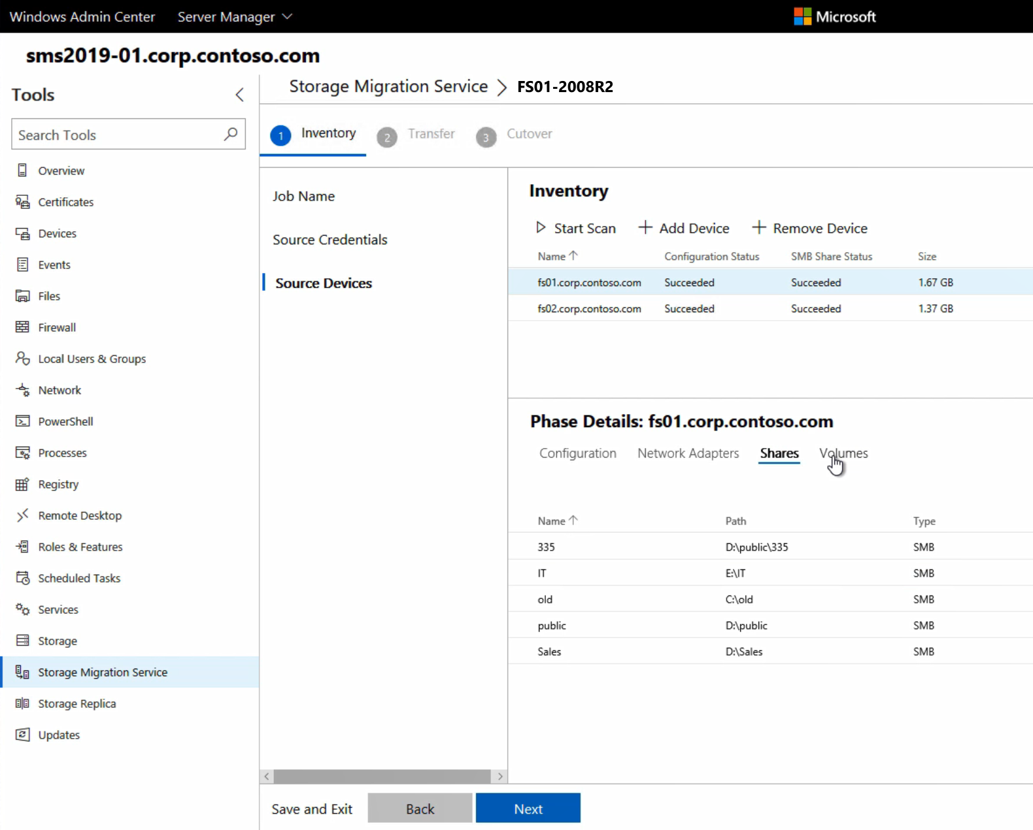
Windows Admin Center
Over 1.7 Million servers under management!

Slide 7
RDS 2019 and Windows Virtual Desktop
Windows Virtual Desktop ideal if you want…
Microsoft to manage the brokering platform as a service
Windows 10 Enterprise multi-session capabilities, free Windows 7 ESU
Office365 ProPlus capabilities
RDS 2019 ideal if you want…
full end-to-end control of the desktop virtualization environment
in-place upgrade of existing Windows Server RDS environment
to extend current deployments

Slide 8
Storage Migration Service Vision
Migrate unstructured data from anywhere into physical, virtual, and IaaS
Fast, consistent, scalable
Takes care of complexity
An elegant graphical workflow

Slide 9


Slide 10
Azure
SMB
Azure Files
IaaS
SMB
SMB
Azure File Sync
Windows Server physical, VMs, Azure Stack IaaS
Storage Migration Service
Data and config
On-Prem
Windows Servers
SMB shares
WS2003
WS2008/R2
WS2012/R2
WS2016
WS2019

Slide 11
Azure
SMB/NFS
Azure Files
Azure DB Target
IaaS
Azure Databox Edge
SMB/WF
SMB/WF
Azure
Databox
WS Traditional On-Prem, VMs, Azure Stack IaaS
Azure File Sync source
Storage Migration Service
NDMP/SMB/NFS
Block & File over SMB
File over SMB & NFS
3rd Party Storage
Legacy Windows Servers
OSS Servers
SMB/NFS
SMB/NFS shares
Dell/EMC
NetApp
HPE
NAS
WS2003
WS2008/R2
WS2012/R2
WS2016
WS vNext
Samba
Linux

Slide 12
Inventory
Passive (no agent)
Run from WS2019 Orchestrator
Create job
Create job
Include volumes
Scan config
Network
Volumes
OS Info
Scan SMB
File Count
File Sizes
Share Properties
Ready for transfer

Slide 13
Transfer
Map destinations
Map volumes
Skip shares
Include source
Retry flags
Preservation
Checksum
Validate
Transfer
Delta rerun
Report
Ready for cutover

Slide 14
Cutover
Map networks
Set IP
Set new name
Max duration
Validate
Cutover
Job complete

Slide 15



Azure Point-to-site VPN
Point-to-site for client and servers
Azure NIC in Windows Admin Center makes it easy!
Internet
Public IP
VMs
Virtual Gateway
P2S
S2S
Services
Express Route

Slide 16
Azure Network Adapter in Windows Admin Center
Easy setup for your server to establish a Point-to-site connection to your Azure virtual network.
Takes care of Azure Virtual Gateway creation
Handles self-signed certificates, or user generated
Auto-reconnect is enabled
Connection is persistent when not logged in

Slide 17
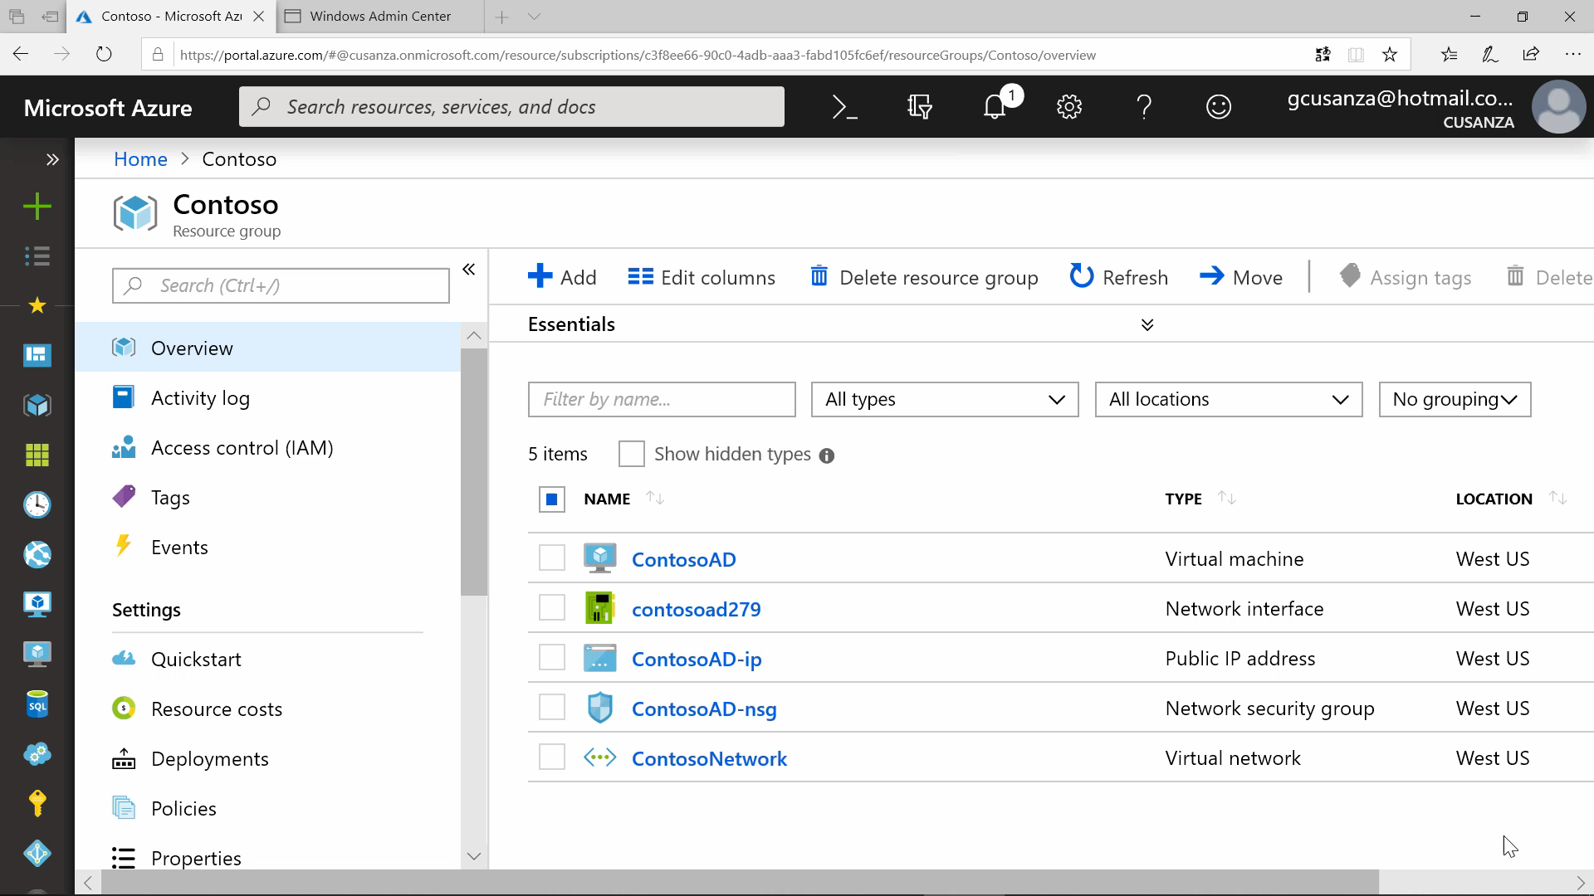

Slide 18

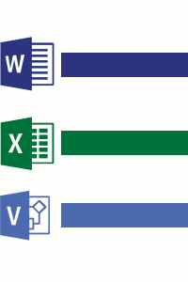
How does Deduplication Work in Windows 2019
#1 – Scans the Files system for files meeting the optimization policy
#2 – Breaks the files into Variable Sized Chunks

Slide 19
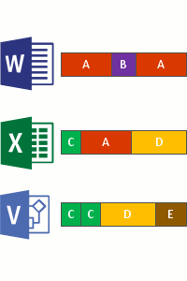
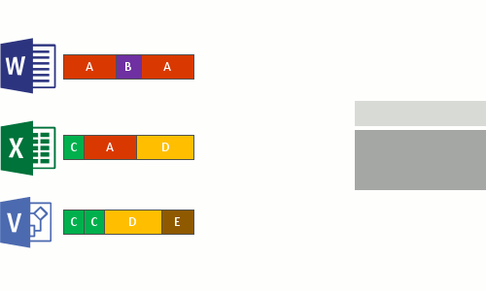
How does Deduplication Work in Windows 2019
#3 – Identifies unique chunks
#4 – Places the files in the chunk store and optionally compresses

Slide 20
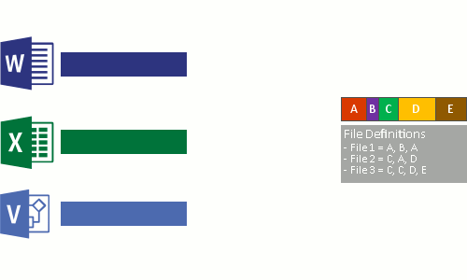
How does Deduplication Work in Windows 2019
#5 – Replace the original file with a reparse point to the chunk store
#6 – Files are read via the Deduplication Filter Driver dedup.sys

Slide 21
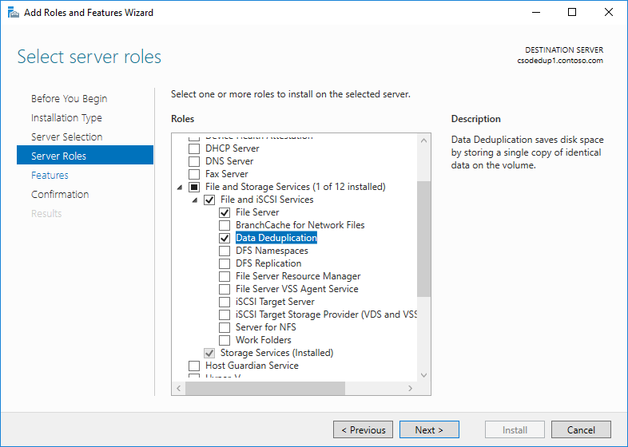
Installing Deduplication in Windows Server 2019
Install-WindowsFeature -Name FS-Data-Deduplication

Slide 22
Predictive Analytics for the Intelligent Edge
Volume consumption forecasting
Total storage consumption
forecasting
CPU capacity
forecasting
Network capacity forecasting
System Insights is a platform allows adding new capabilities across future releases.

Slide 23
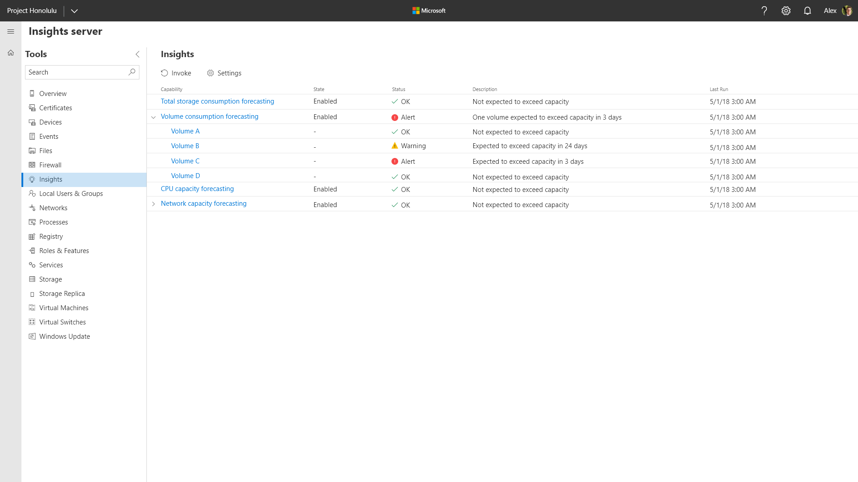
Windows Admin Center

Slide 24
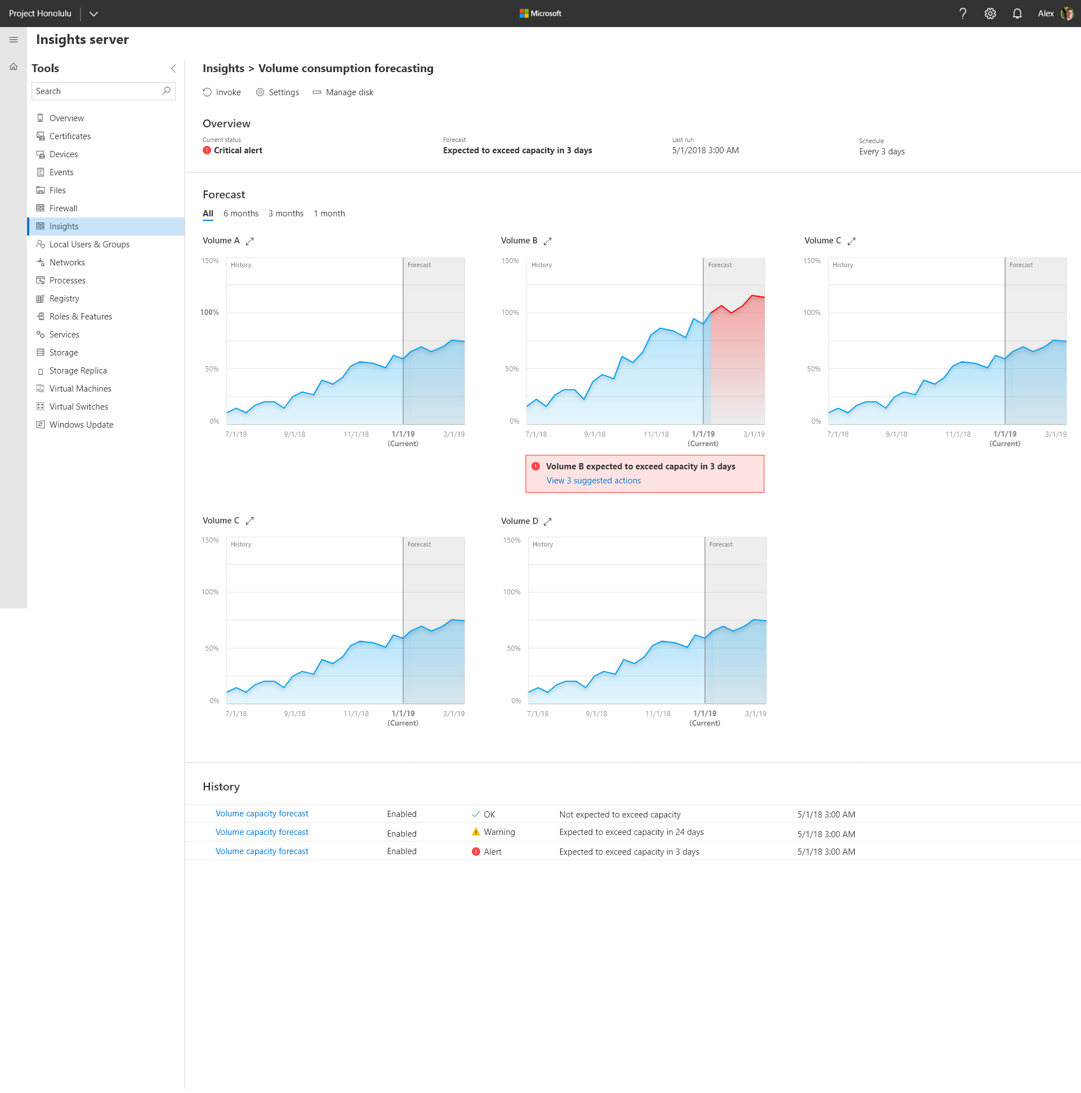
Windows Admin Center

Slide 25
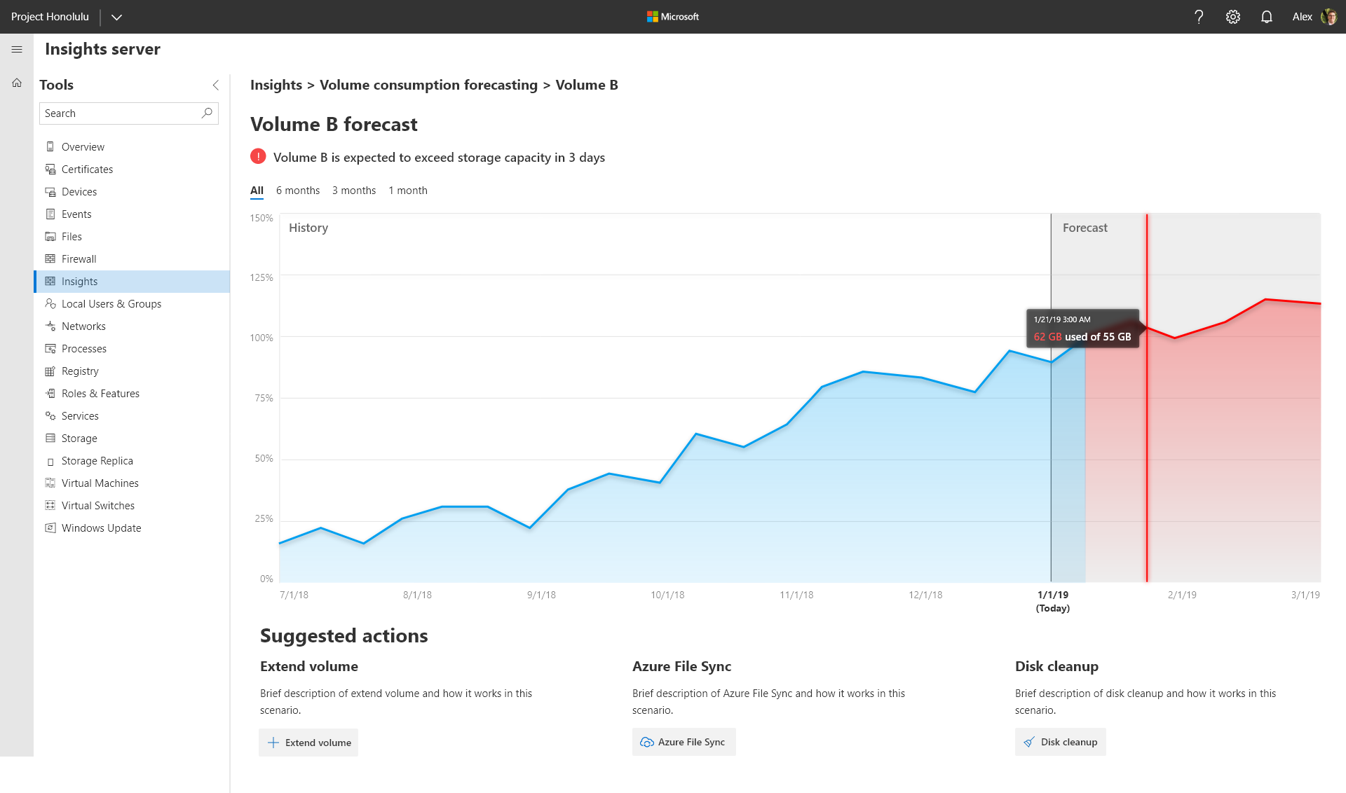
Windows Admin Center

Slide 26


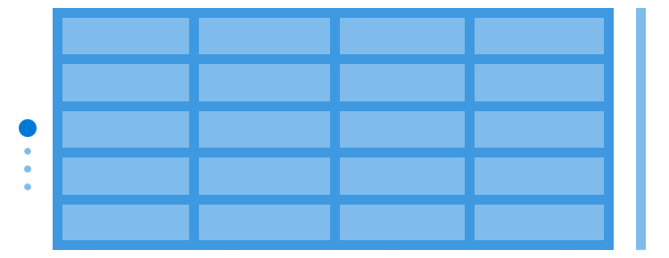
Ethernet switches
Misc. appliances
Ethernet switches
Hypervisors
Standard x86 servers
+
Local drives
+
The magic of software
Storage fabric
Storage (SAN)
Traditional Infrastructure
Hyper-Converged Infrastructure (HCI)

Slide 27
Unprecedented hyper-converged infrastructure
Evolve your datacenter infrastructure to achieve greater efficiency and security
Windows Admin Center management
Best for two-node HCI at the edge
Industry-leading performance and scale
Storage Class Memory support

Slide 28
Enhanced security capabilities
Elevate your security posture by protecting the datacenter starting with the operating system
Shielded VMs for Linux
Integrated Windows Defender ATP
Exploit Guard
System Guard Runtime

Slide 29
Application Innovation
Windows Server 2019
Windows Server, version 1803
Optimized Server Core image
App compat improvements
Enhanced Group Managed Service Account support
Platform functionality for Kubernetes and Microsoft Service Fabric
Performance and density improvements
Platform and open source work on CNI networking plugins such as Calico and Flannel
Enhancements to the Windows Subsystem for Linux
…you will have to wait
Optimized Server Core image
App compat improvements
Native command line tools—curl.exe, tar.exe and SSH
Enhancements to the Windows Subsystem for Linux
Networking enhancements for greater density and quicker endpoint creation
Improved network security with Calico Open source storage plugins for Kubernetes
Platform functionality required for Kubernetes conformance
Windows Server, version 1709
Windows Server 2016
Optimized container images for Nano Server and Server Core
Platform level support for Linux containers
Windows Subsystem for Linux
Networking enhancements for overlays and SDN
Initial launch of containers
Process and Hyper-V isolation
Docker EE Basic Included at no additional cost

Slide 30
Faster innovation for applications
Enable developers and IT pros to create cloud native, modernize their traditional apps using containers and micro-services
Linux Containers on Windows host
Service Fabric & Kubernetes for container orchestration
Windows Subsystem for Linux
Optimized Images for Server Core and Nano Server

Slide 31

SQL Server 2019 Preview
1. Harness the power of big data
2. Bring AI to your workloads
3. Eliminate the need for data movement
4. Explore and interact with visual data
5. Run real-time analytics on operational data
Big data clusters with scalable compute and storage composed of SQL Server, Spark, and HDFS. Cache data in scale-out data marts.
A complete AI platform to train and operationalize models in SQL Server ML Services or Spark ML using Azure Data Studio notebooks.
Data virtualization allows queries across relational and non-relational data without movement or replication.
Visual data exploration and interactive analysis using SQL Server BI tools and Power BI Report Server.
In-memory technologies for analytics on operational data using HTAP. Higher concurrency and scale through persistent memory.
6. Automatically tune SQL Server
7. Reduce database maintenance and increase business uptime
8. Boost security and protect data in use
9. Track compliance with sophisticated resources
10. Optimize with choice and flexibility
Intelligent Query Processing improves scaling of queries and Automatic Plan Correction resolves performance problems.
Greater uptime with more online indexing operations. Now run Always On availability groups on containers using Kubernetes.
SQL Server enables layers of security including protection of computations in Always Encrypted secure enclaves.
Data Discovery & Classification labeling for GDPR and Vulnerability Assessment tool to track compliance.
Support for your choice of Windows, Linux, and containers. Run Java code on SQL Server and store and analyze graph data.

Slide 32
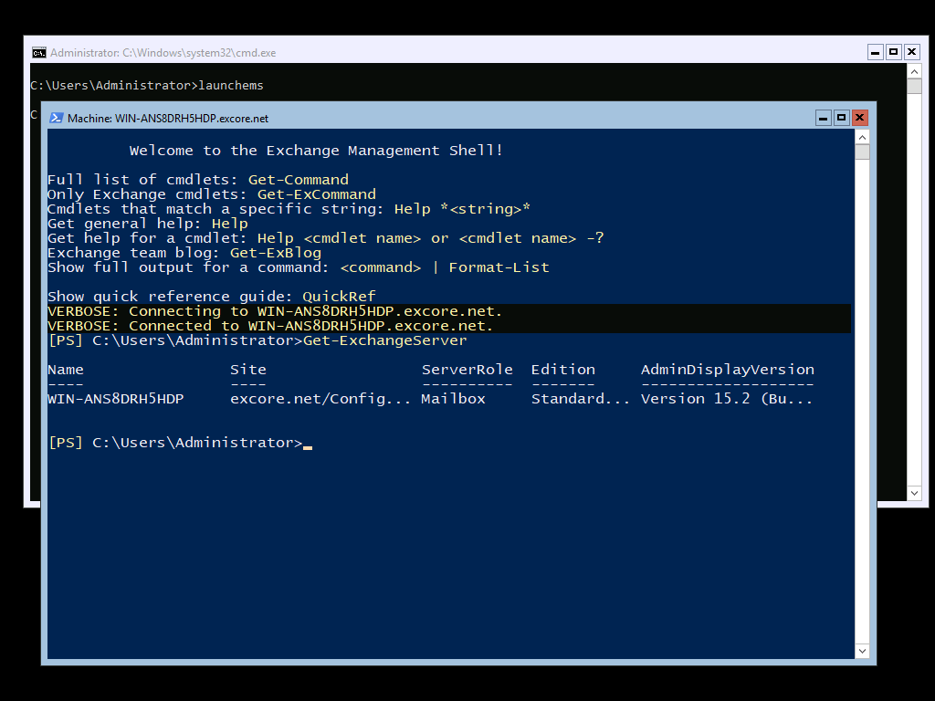
Exchange Server 2019 Preview
PLACEHOLDER
Now supported in Server Core!

Slide 33
System Center 2019
Support Windows Server 2019
Best-in-class Operations
Extensible management to multiple systems
Azure integration
Coming in H1 2019

Slide 34











Windows Admin Center complements existing management solutions
Cloud/hybrid deployments
Azure security and management
System Center
Windows Admin Center
Remote Server Administration Tools
Remote Desktop + in-box tools
Large deployments
Small deployments

Slide 35
Time to upgrade the platforms
Windows Server 2008/R2
January 2020
SQL 2008/R2
July 2019
You are here
2017
2018
2019
2020

Slide 36
Free on Azure
Customer Options for 2008 End of Support
Migrate to Azure
Get 3 years of free Extended Security Updates
1
2
Plan upgrade to Windows Server 2019
Windows Server 2008 and 2008 R2
Extended support
ends January 14, 2020
2018
2019
2020
Stay On-Premises
Buy up to 3 years of Extended Security Updates
1
2
Upgrade to Windows Server 2019

Slide 37
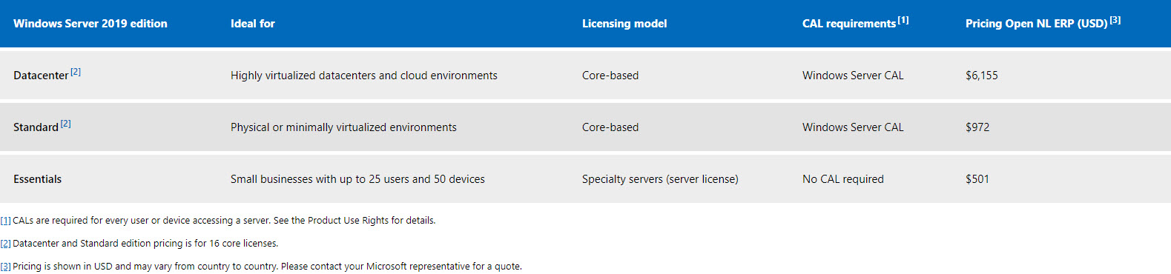
Pricing
Compare to Server 2016
Datacenter = $6,155
Standard = $882

Slide 38
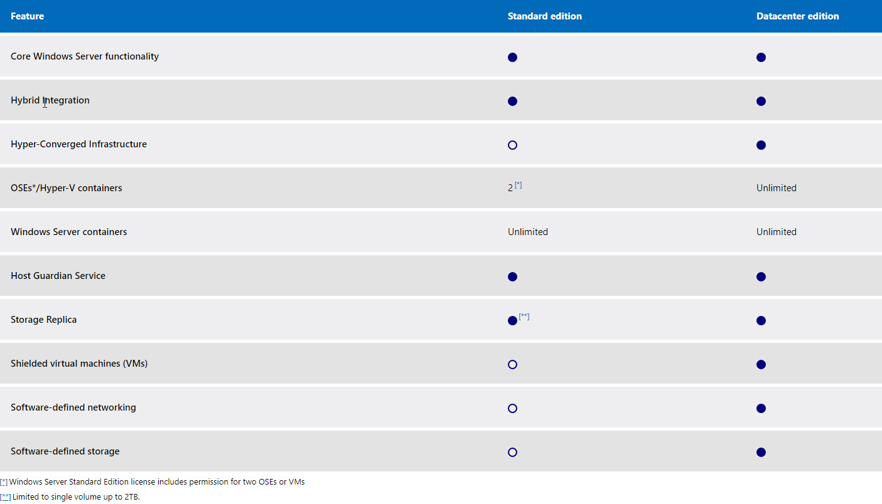

Slide 39
Huge savings for Windows Server and SQL Server on Azure
$
2
$
+ Azure Reserved Instances
$
$
+ Azure Hybrid Benefit
1
$
X3 =
$
Azure
AWS

Slide 40
Save MORE for Windows Server and SQL Server 2008/R2 on Azure
$
2
$
+ Azure Reserved Instances
$
+ Azure Hybrid Benefit
$
+ Free Extended Security Updates
$
$
1
X5 =
$
$
$
Azure
AWS

Slide 41
What’s next?

Slide 42

Long-Term Servicing Channel
Semi-Annual Channel
General purpose file servers, first and third-party workloads, traditional, apps, and other infrastructure roles
Containerized applications, container hosts, and application scenarios benefiting from faster innovation
RECOMMENDED SCENARIOS
Every 2–3 years
Every 6 months
NEW RELEASE
5 years of Mainstream support +5 years of Extended support
18 months
SUPPORTED FOR
All available Windows Server editions
Standard and Datacenter
EDITIONS
All customers through all channels
Software Assurance and Cloud customers only
WHO CAN USE
Server Core and Server with Desktop Experience
Server Core and Nano Server container image
INSTALLATION OPTIONS

Slide 43
Looking forward
INSIDERS
Every 2 weeks
SEMI-ANNUAL CHANNEL
October 2017
April 2018
September 2018
H1/CY2019
H2/CY2019
Windows Server, version 1709
Windows Server, version 1803
Windows Server, version 1809
Windows Server, version 19XX
Windows Server, version 19XX
Every 6 months
LONG-TERM SERVICING CHANNEL
October 2016
September 2018
Windows Server 2016
2-3 Years
Windows Server 2019
2-3 Years

Slide 44
Thanks!

